Slide 1
Asymmetric Cryptography
Information SECURITY

Slide 2
Asymmetric Cryptography
Introduction
Public Key Encryption
Public Key Cryptosystem
Characteristics

Slide 3
Introduction
All cryptographic systems based on permutation & substitution
Rotor machines for encryption & decryption
Rotor machines were devices created in the early 1920s that used electromechanical systems to encrypt and decrypt messages using intricate internal mechanisms. They are made up of rotating discs or rotors that use a straightforward substitution cipher to scramble the letters in a plaintext message
With the availability of computers, more complex systems were devised like DES, AES.

Slide 4
Introduction
Public-key Cryptography
Public-key cryptography based on mathematical functions rather than permutation & substitution
Public-key Cryptography is asymmetric, used two key for encryption/decryption
Misconceptions:
Public-key algorithms are secure
Public-key encryptions obsolete symmetric encryption
Key distribution

Slide 5
Public Key Encryption
Principles:
Security is compromised due to third party
Digital signature
Developed to address two key issues:
key distribution – how to have secure communications in general without having to trust at key distribution center(KDC) with your key
digital signatures – how to verify a message comes intact from the claimed sender
Idea proposed in 1976 by Diffie-Hellman
Each user generated a pair of keys
Each user places one key in public ring and second is private key

Slide 6
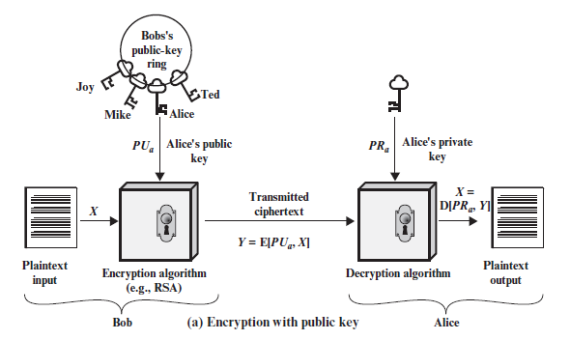
Public Key Encryption

Slide 7
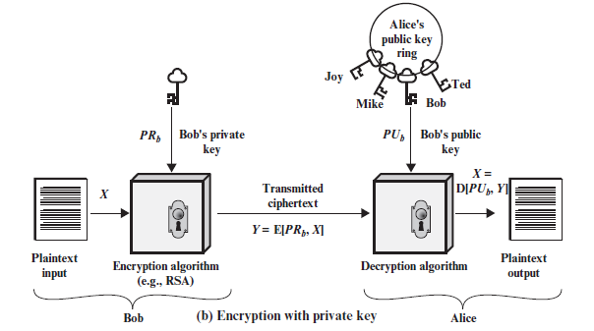
Public Key Encryption

Slide 8
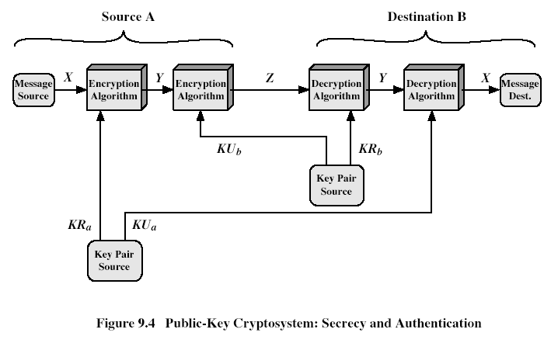
Public Key Crypto Systems

Slide 9
Characteristics of Public-Key Encryption
Public-Key algorithms rely on two keys which have following characteristics:
Computationally infeasible to find decryption key knowing only algorithm & encryption key
Computationally easy to en/decrypt messages when the relevant (en/decrypt) key is known
Either of the two related keys can be used for encryption, with the other used for decryption (in some schemes)

Slide 10
Diffie-Hellman Key Agreement
Algorithm
Example
MITM attack

Slide 11
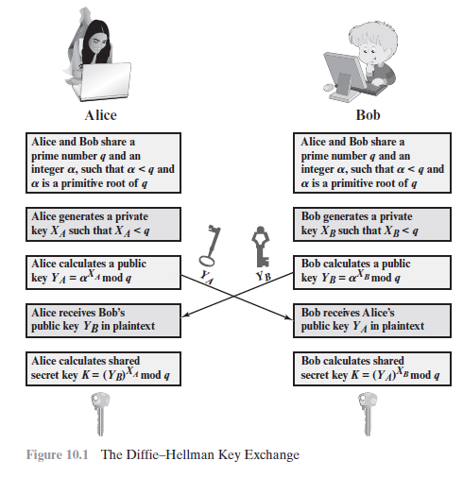
Diffie-Hellman

Slide 12
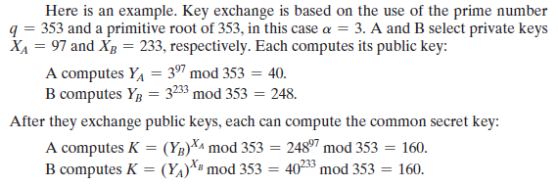
Example

Slide 13
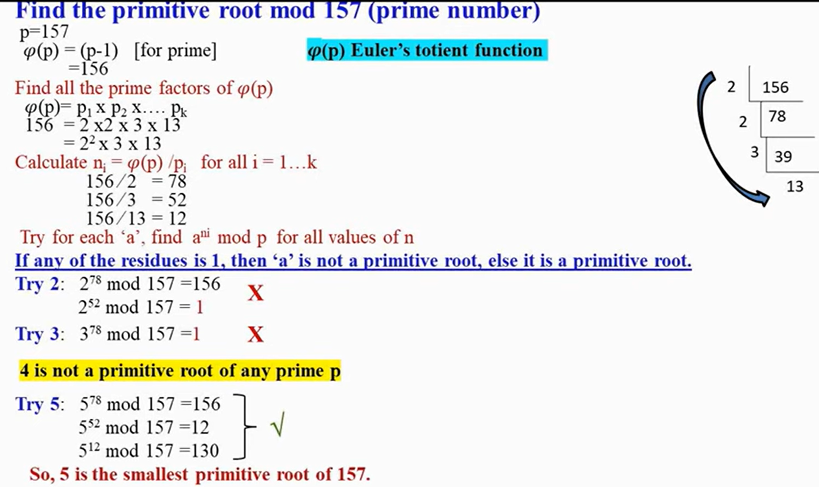
How to find the primitive root of prime Number 157
Distinctive Numbers become the minimum primitive root of any Number

Slide 14
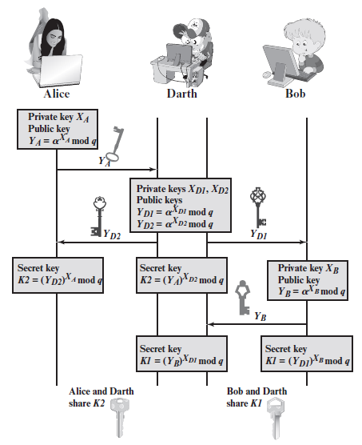
MITM Attack
Successful MITM execution has two distinct phases: interception and decryption.
The first step intercepts user traffic through the attacker’s network before it reaches its intended destination.
The most common (and simplest) way of doing this is a passive attack in which an attacker makes free, malicious WiFi hotspots available to the public. Typically named in a way that corresponds to their location, they aren’t password protected. Once a victim connects to such a hotspot, the attacker gains full visibility to any online data exchange.
After interception, any two-way SSL traffic needs to be decrypted without alerting the user or application. A number of methods exist to achieve this:

Slide 15
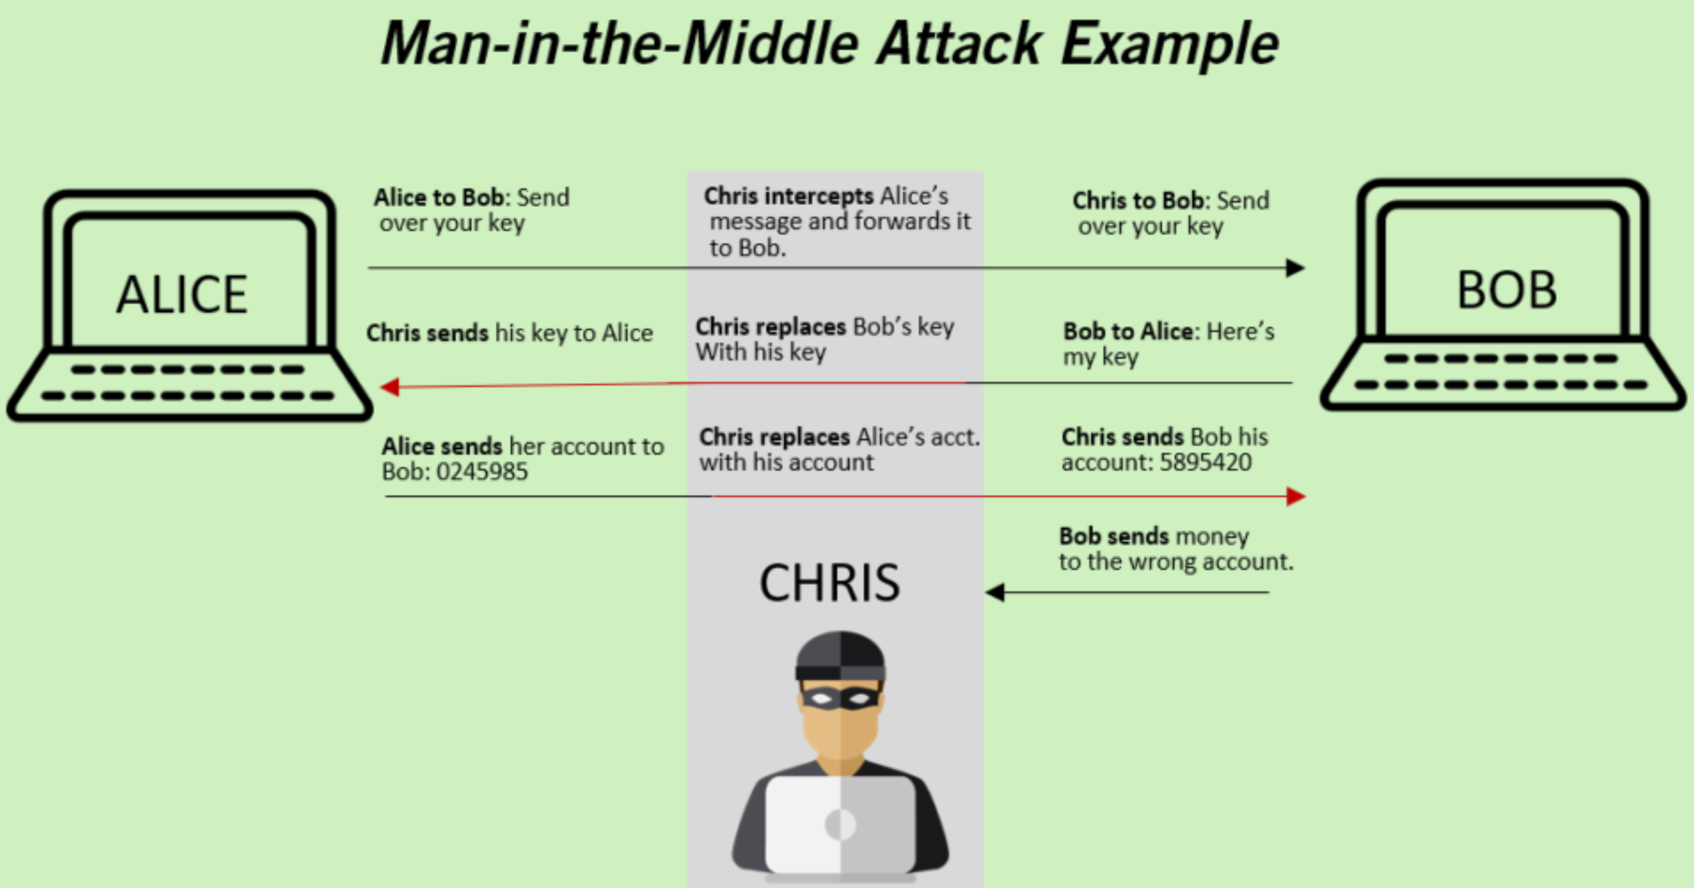

Slide 16
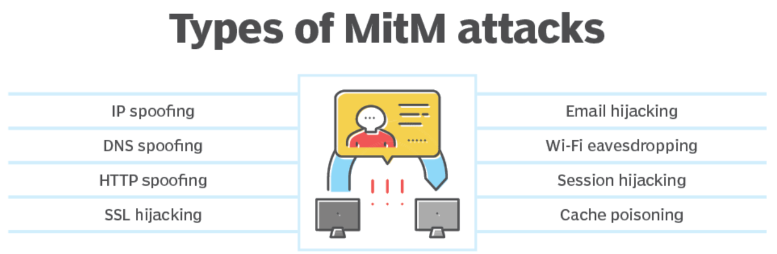

Slide 17
RSA
Introduction
Algorithm
Example
Attack

Slide 18
Public Key Encryption : RSA
Public key encryption enables a sender and a receiver to communicate securely over an insecure channel
The idea behind public key encryption is that it should be easy for anyone to encrypt a message, but computationally infeasible for anyone to decrypt it unless they have some “special knowledge”
This “special knowledge” could be considered to be a decryption key (also known as a private key)

Slide 19
Rivest-Shamir-Adleman (RSA)
Each person that wants to be able to receive encrypted messages must generate a RSA key pair
The RSA key pair is comprised of a public key (that is shared with the sender and anyone else that may want to send encrypted messages to the receiver) and a private key (that is kept secret by the receiver)
The public key is used by the sender to encrypt messages to the receiver
The private key is used by the receiver to decrypt messages
The RSA key generation algorithm generates a public key and a secret key (RSA key pair)

Slide 20
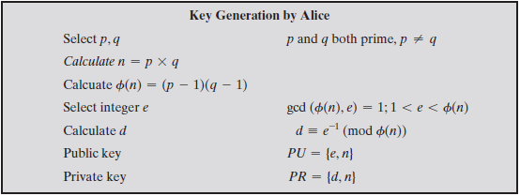
RSA Key Generation

Slide 21
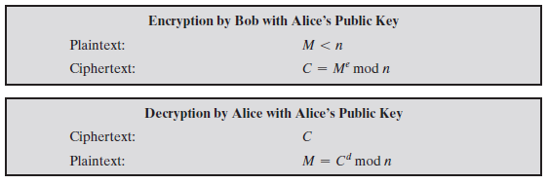
Encryption and Decryption

Slide 22





Example
Choose p = 3 and q = 11
Compute n = p * q = 3 * 11 = 33
Compute φ(n) = (p - 1) * (q - 1) = 2 * 10 = 20
Choose e such that 1 < e < φ(n) and e and φ(n) are coprime.
Let e = 7
Compute a value for d such that (d * e) % φ(n) = 1.
One solution is d = 3 => [(3 * 7) % 20 = 1]
Public key is (e, n) => (7, 33)
Private key is (d, n) => (3, 33)
Let message M be 7 < n
The decryption of C= (Me % n) => C = 7⁷ % 33 = 28
The encryption of M = (C^{d} % n) =m = 28³ % 33 = 7

Slide 23


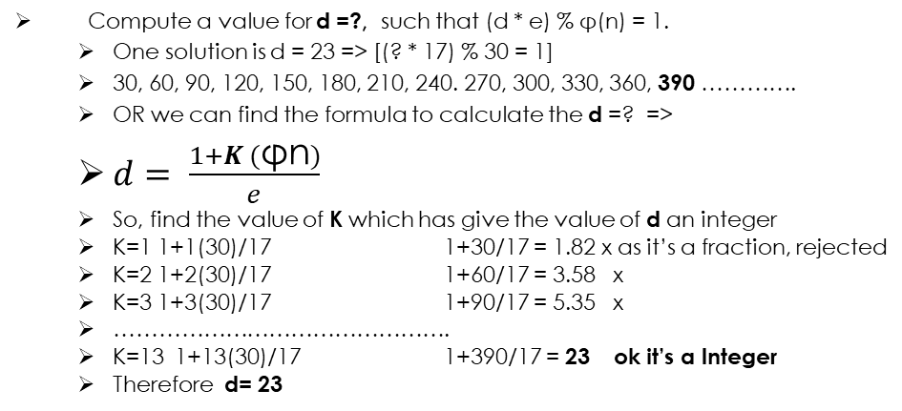

Example 2
Choose p = 4 and q = 11
As we don’t have n lets find n first
Compute n = p * q = 4 * 11 = 44
Compute φ(n) = (p - 1) * (q - 1) = 3 * 10 = 30 So φ(n) = 30
Let us choose e which is between 1 < e < 30 Where e and φ(n) are coprime.
Let e = 17 SUCH THAT THEIR GCD (17, 30)=1
Remember!!!
Choose e such that 1 < e < φ(n) and e and φ(n) are coprime.
NOTE:
n = 44
φ(n) = 30
e = 17
d = 23
Compute a value for d =?, such that (d * e) % φ(n) = 1.
One solution is d = 23 => [(? * 17) % 30 = 1]
30, 60, 90, 120, 150, 180, 210, 240. 270, 300, 330, 360, 390 ………….
OR we can find the formula to calculate the d =? =>
$d= \frac{1+K (\text{φn})}{e}$
So, find the value of K which has give the value of d an integer
K=1 1+1(30)/17 1+30/17 = 1.82 x as it’s a fraction, rejected
K=2 1+2(30)/17 1+60/17 = 3.58 x
K=3 1+3(30)/17 1+90/17 = 5.35 x
……………………………………….
K=13 1+13(30)/17 1+390/17 = 23 ok it’s a Integer
Therefore d= 23
+-
Public key (PU) is (e, n) => (17, 44) & Private key (PR) is (d, n) => (23, 44)
Now, lets do the encryption and Decryption process where Message is:
M<n => M<44, So let’s choose Message to be any value <44 i.e., M=13
The encryption of (Me % n) =C => 13¹⁷ % 44 => 29 is the cyphertext
The decryption of (C^{d} % n) = M =>29²³ % 44 is M = 13
which will give you the Original Plain Text.

Slide 24
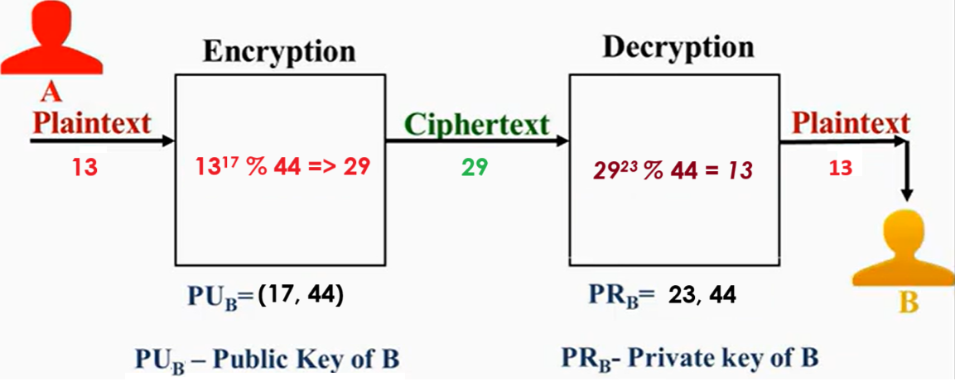
Transmitting RSA Encoded Message

Slide 25
Security of RSA
Eve knows the public key (e, n) of Bob and wants to know his private key (d, n) so she can decrypt messages sent to Bob
To calculate d, she has to solve the equation: d = e⁻¹ (mod (p-1)(q-1))
However, this means that she needs to know the prime numbers p and q
She knows that n is the product of p and q, so she can recover p and q if she can factor n into its component prime numbers
Factoring large integers (over 250 digits) is known to be a difficult problem in mathematics and computer science and provided that the prime factors of n are sufficiently large, it would be computationally infeasible for Eve to calculate p and q (and hence d) from Bob’s public key

